Slide 1

Advanced Python Libraries: Powering the Future
Python reigns as the top language on the TIOBE Index in 2024. It boasts over 500,000 packages on PyPI. Advanced libraries are driving innovation across tech and science.
Name : dholeriya vishal
Enrollment No : 2302031000133

Slide 2




Why Dive into Advanced Libraries?
Accelerated Development
Industry Adoption
90% of data science teams rely on core libraries.
Reduce boilerplate code and speed up project timelines.
Real-World Impact
Achieve faster prototyping and efficient deployment.

Slide 3
NumPy: The Backbone of Numerical Computing
Core Functionality
Real-World Impact
N-dimensional arrays
Powers scientific computing and deep learning workflows. Used by NASA for data analysis.
Broadcasting
Vectorization
NumPy is crucial for numerical operations. It is used in 75% of machine learning codebases.

Slide 4
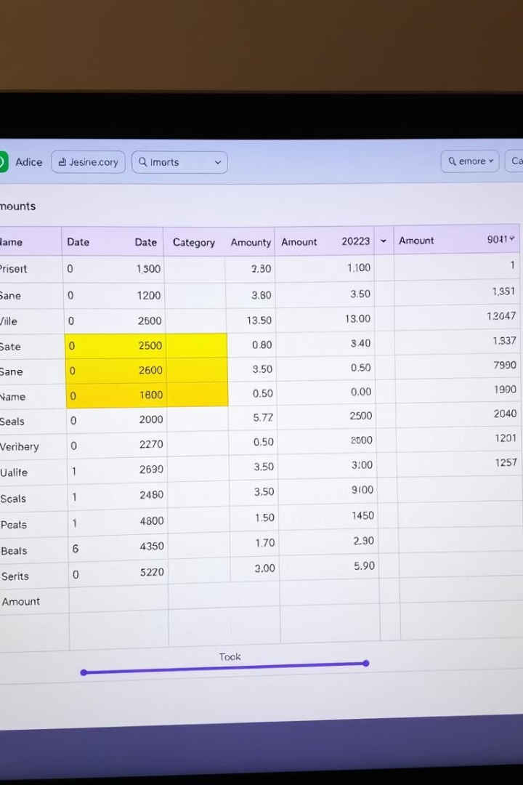
Pandas: Data Analysis Powerhouse
Scalable Data Handling
Industry Adoption
Manages millions of rows using DataFrame structures.
Used by JP Morgan, Netflix, and Spotify for analytics.
Key Features
Handles missing data, time series, and merging datasets.
Pandas excels at data manipulation and analysis. Its versatility makes it a favorite in the industry.

Slide 5




Scikit-learn: Machine Learning Simplified
Diverse Algorithms
Features 100+ algorithms.
Popular Usage
Used in 70,000+ GitHub projects.
Key Features
Offers model evaluation and pipelines.
Scikit-learn makes machine learning accessible. It covers classification, regression, and clustering.

Slide 6






TensorFlow: Scaling Deep Learning
Hardware Support
Runs on CPUs, GPUs, and TPUs for flexibility.
Google's Creation
Developed by Google for advanced AI tasks.
Applications
Powers speech recognition and translation engines.
TensorFlow excels at deep learning at scale. Its vast ecosystem supports diverse applications.

Slide 7



Requests: HTTP for Humans
Most Downloaded
Top Python library.
Streamlined APIs
Eases REST API integration.
Automation
Automates web tasks.
Requests simplifies HTTP interactions in Python. It is widely used for web automation and data collection.

Slide 8




Asyncio: The Power of Asynchronous Programming
Native Support
Built into Python 3.
Concurrent Tasks
Enables networking and I/O tasks.
Performance Boost
Improves high-throughput apps.
Asyncio provides asynchronous programming capabilities. It enhances performance for high-demand applications.

Slide 9

Emerging Trends in Python Libraries
20%
GPU
Year-over-year growth in open-source contributions, fostering a vibrant ecosystem
Rise of GPU-accelerated libraries like PyTorch, RAPIDS optimizing performance
Finance
Growing adoption in finance, revolutionizing data analysis and algorithmic trading
The Python library ecosystem is continuously evolving. New libraries emerge to tackle modern challenges.

Slide 10

Conclusion: Embrace Advanced Python
Career Growth
Continuous Learning
Success Stories
Mastering libraries is key to career advancement.
Explore documentation and community forums.
Dropbox, YouTube, and CERN use Python libraries.
Leverage Python's advanced libraries to drive innovation. Embrace continuous learning for future success.

Slide 11
REFERENCE

Slide 12

Thank You
Thank you for your attention. Let's leverage advanced Python libraries to build amazing things.

